Slide 1
Test Automation Introduction
Notes:
Welcome everyone to the Session

Slide 2
Context
Introduction to test automation
Web Elements
Operations Performed on the Web Elements
Locate Web Elements
Browser Actions
Navigation Actions
WebElement Actions
Automation Testing Tool : Selenium
What Selenium can do
Selenium WebDriver
How to use Selenium WebDriver
Demo: Verify page title
Notes:
Explain context we are going to cover in the session

Slide 3
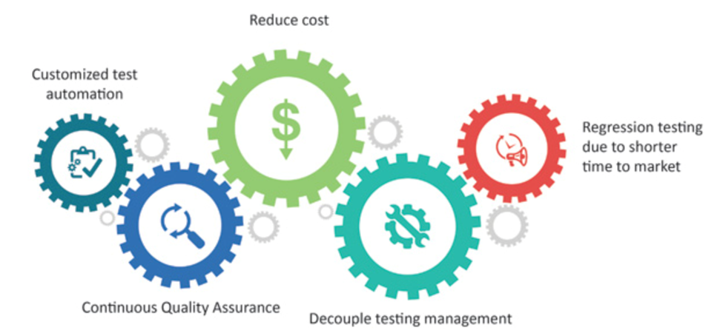
Introduction to Test Automation
Automation testing is a Software testing technique to test and compare actual outcomes with expected outcomes. This can be achieved by writing test scripts or using any automation testing tool.
It is faster than manual testing, requires a smaller investment in human resources, helps prevent errors, makes it easier to execute tests and increases the frequency of runs, and supports regression testing and functional testing.
Notes:
Give Introduction about automation
Advantages of test automation
accurate results than compare to manual testing

Slide 4
Basic activity
Identify web page elements and Objects
Locate the elements
Perform actions on the elements
Perform the verification at verification points
Validate the results
Share the results
Repeat the operations
Perform operation on timely basis
Notes:
What are basic activities we are doing in test automation has to explain

Slide 5
Introduction to Web Elements
Anything that is present on the web page is a WebElement such as text box, button, etc.
Types of Web elements
Edit box
Link
Button
Image, image link, an image button
Text area
Checkbox
Radio button
Dropdown list
Notes:
Give introduction of various web elements on web page
Consider the example web page from inhouse applications

Slide 6
Operations Performed on the Web Elements
Operations performed on the browser
Launch the browser
Navigate to a particular web page
Close the current browser
Close all browsers opened by WebDriver during execution
Maximize browser
Refresh the browser
Operations on the web page
Get page title
Get page URL
Operations on edit box
Enter a value
Get the value
Clear the value
Operations on link
Click the link
Return the link name
Operations on button
Click enabled
Display status
Operations on image
General image(No functionality)
Image button(click)
Image link(redirects to another page)
Operations on text area
Return or capture the messages from the web page
Operations on checkbox
Select the checkbox
Unselect the checkbox
Operations on radio button
Select radio button
Check if it displays the radio button
Operations on drop down
Select an item in the list
Get the item count
Operations on frame
Switch from top window to a particular frame on the web page
Switch to a frame to top window
Notes:
Explain the operations performed on the web elements

Slide 7
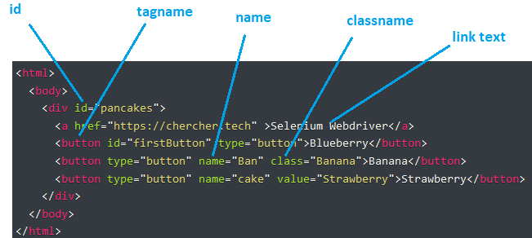
Web Element
An important step with Automation testing is interacting with a web page. Once a framework is in place, and a web page is loaded, automation testers must identify the elements within the HTML DOM (document object model) that the script will use.
So, locating elements within a web page is a crucial step in the process of automating tests.
Notes:
Explain web element in html page and what are the attributes and values

Slide 8
Locate Web Elements
Locators are defined as an address that identifies a WebElement uniquely within a web page.
Types of element locators
Id locator
Name locator
linkText & Partial linkText
CSS Selector
XPath
Notes:
What are the various ways to locate the web elements

Slide 9
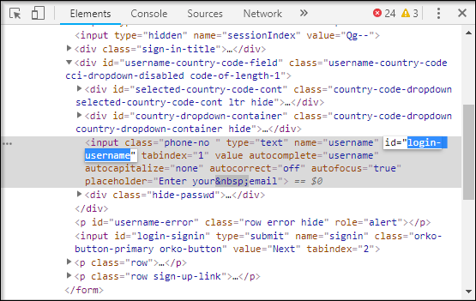
ID Locator
The most popular way to identify web element is to use Id. Id’s are considered as the safest and fastest locator option and should always be the first choice even when there are multiple choices.
Notes:
Explain id locator

Slide 10
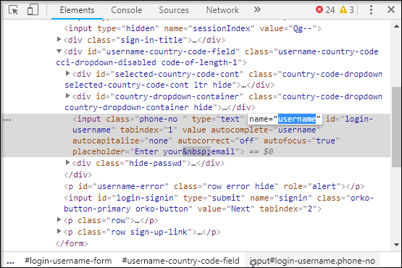
Name Locator
Locate an element with a name attribute; With this strategy, the first element with the value of the name attribute will be returned. If no element has a matching name attribute, then a NoSuchElementException will be raised.
Notes:
Explain about name locator

Slide 11
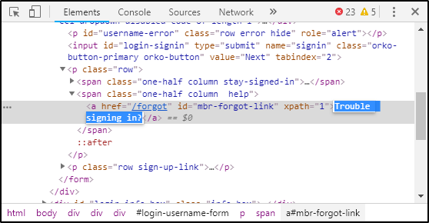
LinkText
You can identify the hyperlinks on a web page using linkText. It can be determined with the help of an anchor tag (<a>).
Find links by a portion of the text in a linkText element. In such situations, you can use Partial Link Text to locate elements.
Notes:
Explain link text

Slide 12
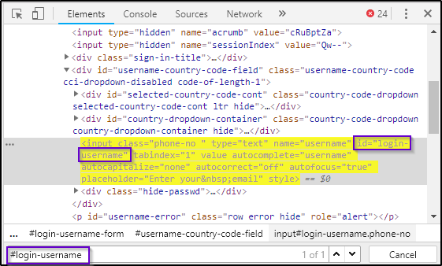
CSS Selectors
The CSS is mainly used to provide style rules for the web pages and you can use it for identifying one or more elements in the web page.
Notes:
Explain css selecter

Slide 13
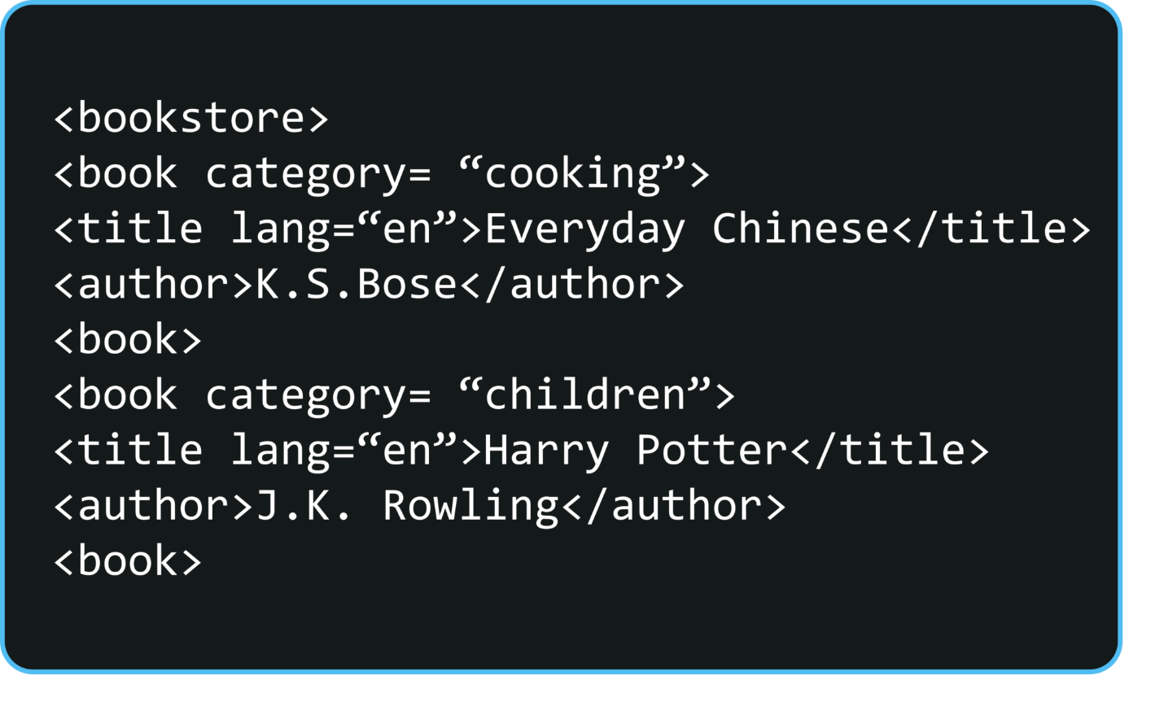
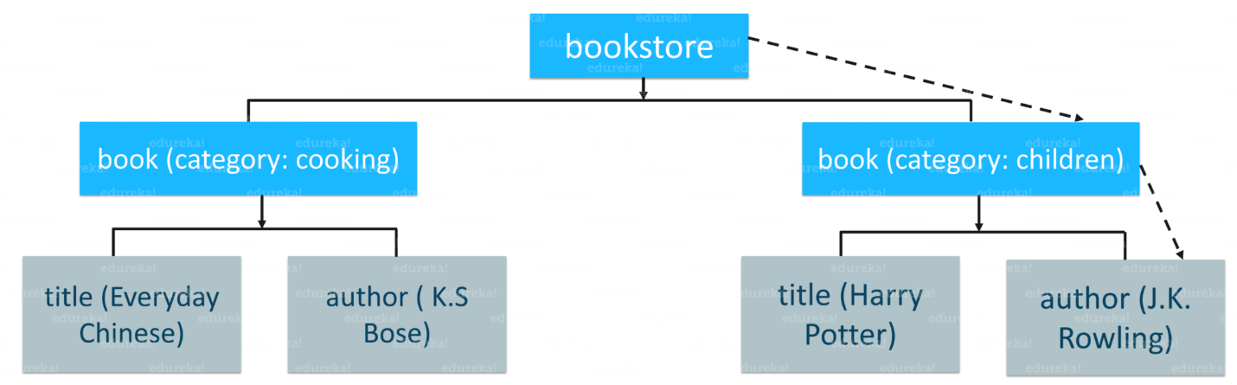
XPath
XPath is also referred to as XML Path is a language to query XML documents.
XPath can be written like:
bookstore/book[@category='children']/author
Notes:
Explain xpath

Slide 14
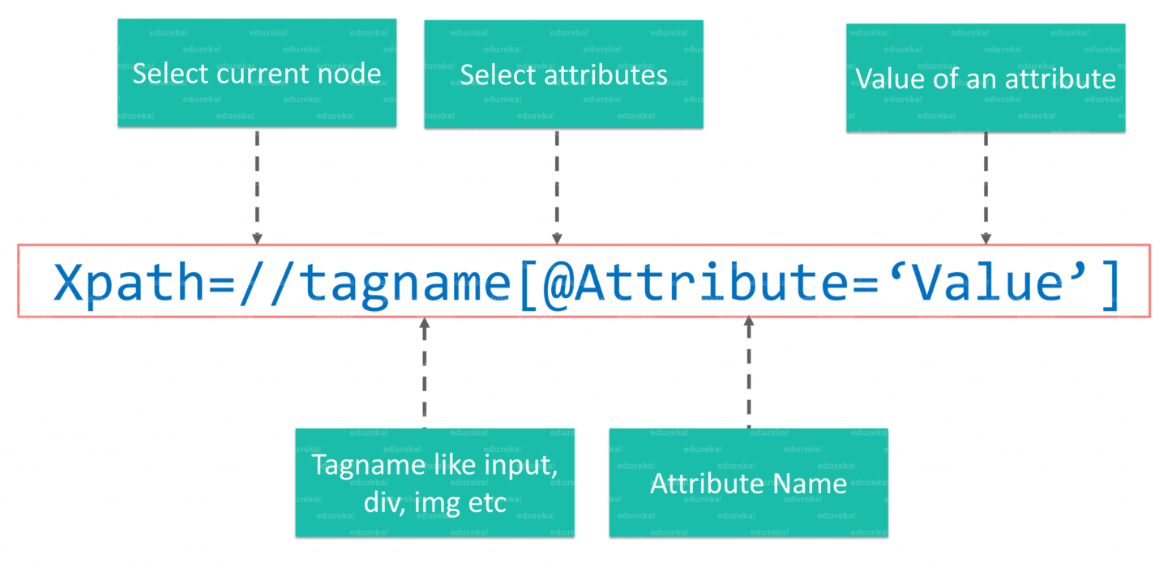
Xpath Syntax
Syntax of Xpath
//: It is used to select the current node.
tagname: It is the name of the tag of a particular node.
@: It is used to select the attribute.
Attribute: It is the name of the attribute of the node.
Value: It is the value of the attribute

Slide 15
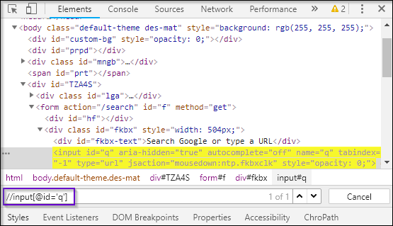
Xpath: Different Types
Absolute Xpath : It is the direct way to find the element
For example: /html/body/div[1]/section/div[1]/div
Relative Xpath : the path starts from the middle of the HTML DOM structure. It begins with the double forward slash (//), which means it can search the element anywhere at the webpage.
For example: //input[@id=‘q]

Slide 16
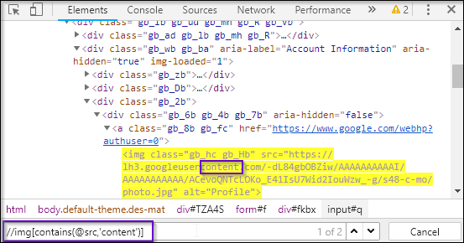
Xpath Functions
XPath Functions
contains()
starts-with()
text()
contains():
any attribute changes dynamically ,It can locate a web element with the available partial text.
//img[contains(@src,’content’)]

Slide 17
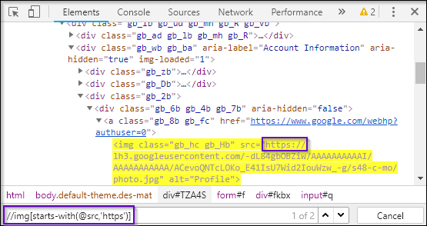
Xpath…continued
starts-with():
match the starting text of the attribute to locate an element whose attribute has changed dynamically
Example XPath query :
//img[starts-with(@src,'https')]

Slide 18
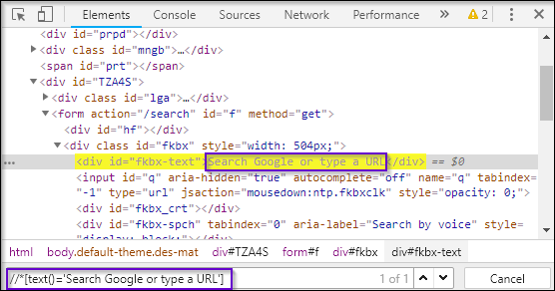
Xpath…continued
text():
This expression is used with the text function to locate an element with exact text.
Example : //*[text()='Search Google or type a URL']
The asterisk(*) implies any tag with the same value

Slide 19
Browser Actions
Launch the web Browser
Load the URL
Get the Page Title
Get the Current Page URL
Get the web page source code
Close the current window
Close the all windows

Slide 20
Navigation Actions
Load web page
Move forward
Move back
Page Refresh

Slide 21
Browser Actions
Clear the test
Click on Element
Set text
Check Element is Displayed
Element Enabled or not
Element Selected or not
Click on Submit
Get Text
Get tag name
Get Size
Get location

Slide 22
Thank you

Slide 23
Navigation Actions
to(String arg0) : void – This method Loads a new web page in the current browser window. It accepts a String parameter and returns nothing.
Command – driver.navigate().to(appUrl);
forward() : void – This method does the same operation as clicking on the Forward Button of any browser. It neither accepts nor returns anything.
Command – driver.navigate().forward();
back() : void – This method does the same operation as clicking on the Back Button of any browser. It neither accepts nor returns anything.
Command – driver.navigate().back();
refresh() : void – This method Refresh the current page. It neither accepts nor returns anything.
Command – driver.navigate().refresh();

Slide 24
WebElement Actions
Clear Command
clear( ) : void – If this element is a text entry element, this will clear the value. This method accepts nothing as a parameter and returns nothing.
Command – element.clear();
Click Command
click( ) : void – This simulates the clicking of any element. Accepts nothing as a parameter and returns nothing.
Command – element.click();
SendKeys Command
sendKeys(CharSequence… keysToSend ) : void – This simulates typing into an element, which may set its value. This method accepts CharSequence as a parameter and returns nothing.
Command – element.sendKeys(“text”);
IsDisplayed Command
isDisplayed( ) : boolean – This method determines if an element is currently being displayed or not. This accepts nothing as a parameter but returns a boolean value(true/false).
Command – element.isDisplayed();

Slide 25
WebElement Actions continued..
IsEnabled Command
isEnabled( ) : boolean – This determines if the element currently is Enabled or not? This accepts nothing as a parameter but returns boolean value(true/false).
Command – element.isEnabled();
IsSelected Command
isSelected( ) : boolean – Determine whether or not this element is selected or not. This accepts nothing as a parameter but returns boolean value(true/false).
Command – element.isSelected();
Submit Command
submit( ) : void– This method works well/better than the click() if the current element is a form, or an element within a form. This accepts nothing as a parameter and returns nothing.
Command – element.submit();
GetText Command
getText( ) : String– This method will fetch the visible (i.e. not hidden by CSS) innerText of the element. This accepts nothing as a parameter but returns a String value.
Command – element.getText();

Slide 26
WebElement Actions continued..
getTagName Command
getTagName( ) : String– This method gets the tag name of this element. This accepts nothing as a parameter and returns a String value.
Command – element.getTagName();
getSize Command
getSize( ) : Dimension – This method fetch the width and height of the rendered element. This accepts nothing as a parameter but returns the Dimension object.
Command – element.getSize();
getLocation Command
getLocation( ) : Point – This method locate the location of the element on the page. This accepts nothing as a parameter but returns the Point object.
Command – element.getLocation();

Slide 27
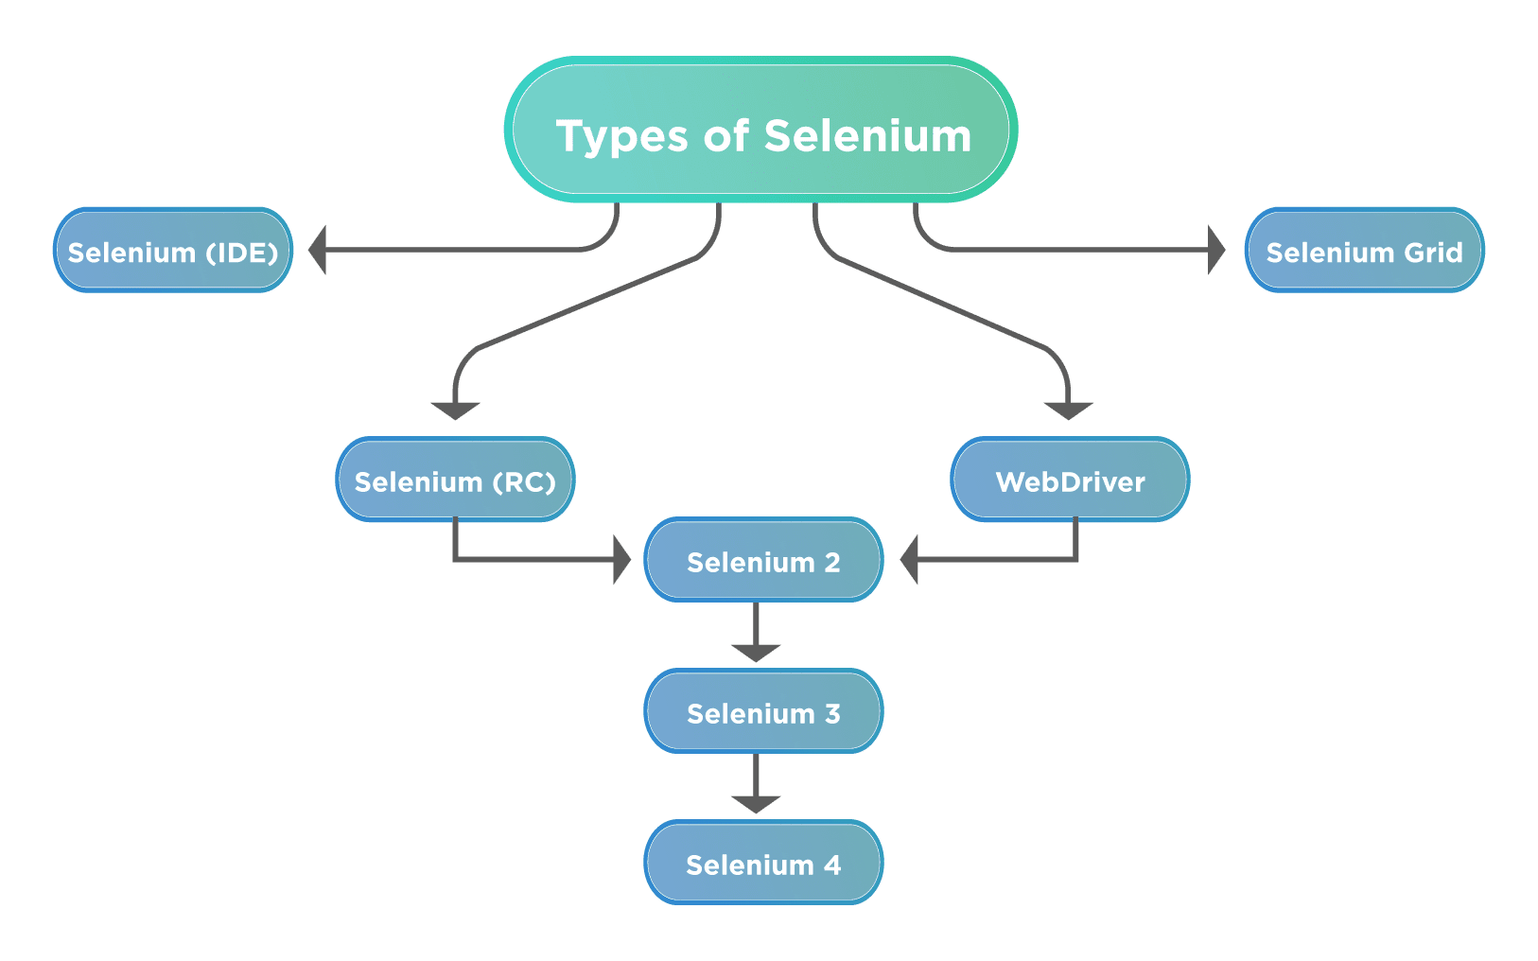
Automation Testing Tool : Selenium
Selenium is a free (open-source) automated testing framework used to validate web applications across different browsers and platforms.
components of Selenium

Slide 28
What Selenium can do
A great solution for automation testing
Simulate user actions
Functional testing
Create regression tests to verify functionality and user acceptance.
Browser compatibility testing
The same script can run on any Selenium platform
Load testing
Stress testing

Slide 29
Selenium WebDriver
WebDriver is designed to providing a simpler and uniformed programming interface
Same WebDriver script runs for different platforms
interact with the browser of their choice, through browser-specific drivers.
Works on the OS level and uses a Protocol called JSONWireProtocol to communicate with browsers.
Support multiple programming language:
Java, C#, Python, Ruby, PHP, Perl…
Supports multiple browsers in multiple platforms
Google Chrome,Internet Explorer,Firefox,Opera,Safari, Chromium

Slide 30
How to use Selenium WebDriver
(1) Go to a page
(2) Locate an element
(3) Do something with that element......
(i) Locate an element
(i+1) Do something with that element
(i+2) Verify / Assert the result

Slide 31
Demo: Verify page title
public static void main( String[] args)
{
// Create a new instance of the Firefox driver
WebDriver driver = new FirefoxDriver();
// (1) Go to a page
driver.get("http://www.google.com");
// (2) Locate an element
WebElementelement = driver.findElement(By.name("q"));
// (3-1) Enter something to search for
element.sendKeys(“empower");
// (3-2) Now submit the form. // WebDriver will find the form for us from the element
element.submit();
// (3-3) Wait up to 10 seconds for a condition
WebDriverWaitwaiting = new WebDriverWait(driver, 10);
waiting.until( ExpectedConditions.presenceOfElementLocated( By.id("pnnext") ) );
// (4) Check the title of the page
if( driver.getTitle().equals(“empower-Google Search") )
System.out.println("PASS");
else
System.err.println("FAIL");
//Close the browser
driver.quit();
}

Slide 32
WebElement Actions
Clear Command
clear( ) : void – If this element is a text entry element, this will clear the value. This method accepts nothing as a parameter and returns nothing.
Command – element.clear();
Click Command
click( ) : void – This simulates the clicking of any element. Accepts nothing as a parameter and returns nothing.
Command – element.click();
SendKeys Command
sendKeys(CharSequence… keysToSend ) : void – This simulates typing into an element, which may set its value. This method accepts CharSequence as a parameter and returns nothing.
Command – element.sendKeys(“text”);
IsDisplayed Command
isDisplayed( ) : boolean – This method determines if an element is currently being displayed or not. This accepts nothing as a parameter but returns a boolean value(true/false).
Command – element.isDisplayed();

Slide 33
WebElement Actions continued..
IsEnabled Command
isEnabled( ) : boolean – This determines if the element currently is Enabled or not? This accepts nothing as a parameter but returns boolean value(true/false).
Command – element.isEnabled();
IsSelected Command
isSelected( ) : boolean – Determine whether or not this element is selected or not. This accepts nothing as a parameter but returns boolean value(true/false).
Command – element.isSelected();
Submit Command
submit( ) : void– This method works well/better than the click() if the current element is a form, or an element within a form. This accepts nothing as a parameter and returns nothing.
Command – element.submit();
GetText Command
getText( ) : String– This method will fetch the visible (i.e. not hidden by CSS) innerText of the element. This accepts nothing as a parameter but returns a String value.
Command – element.getText();

Slide 34
WebElement Actions continued..
getTagName Command
getTagName( ) : String– This method gets the tag name of this element. This accepts nothing as a parameter and returns a String value.
Command – element.getTagName();
getSize Command
getSize( ) : Dimension – This method fetch the width and height of the rendered element. This accepts nothing as a parameter but returns the Dimension object.
Command – element.getSize();
getLocation Command
getLocation( ) : Point – This method locate the location of the element on the page. This accepts nothing as a parameter but returns the Point object.
Command – element.getLocation();

Slide 35
Selenium WebDriver
Selenium-WebDriver
An important component to the overall framework
Helps control and interact with a browser using a scripting language
Very flexible and powerful
Industry standard
Selenium-WebDriver supports multiple browsers in multiple platforms
Google Chrome 12.0.712.0+
Internet Explorer 6+
Firefox 3.0+
Opera 11.5+
Android – 2.3+ for phones and tablets
iOS 3+ for phones
iOS 3.2+ for tablets

